Slide 1

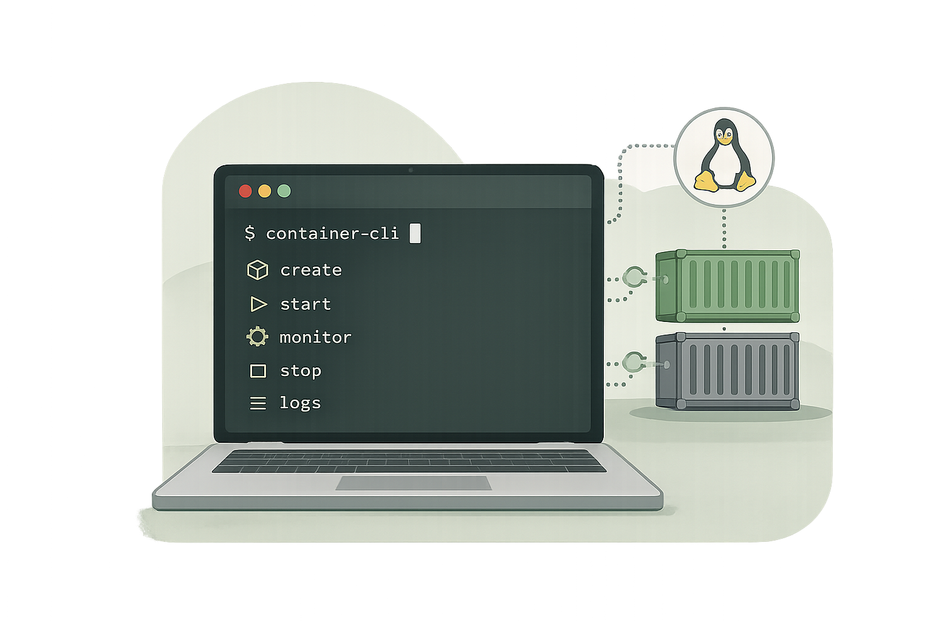
Container Management Shell
Team No 15-Operating systems project
Project Team
Vidya Keerthi Chitturi – 2510030372
Badam Hasika – 2510030403
Madi Amulya – 2510030158
Shaik Asha Parveen - 2510030225

Slide 2
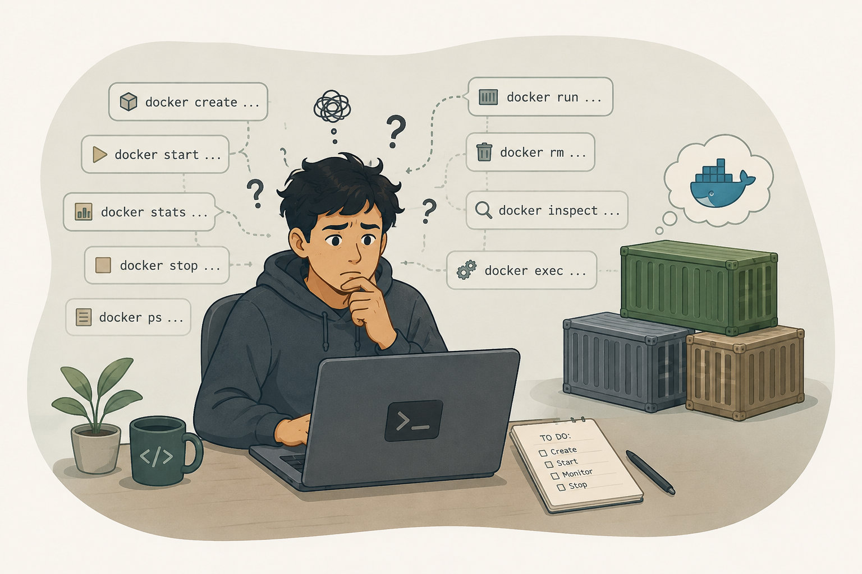


The Problem
Managing Linux containers today means juggling multiple disparate commands – creating, running, monitoring, and stopping containers each require separate tooling and manual steps.
This complexity is repetitive and error-prone, especially for developers working across many containers in modern environments.
This project aims to unify container management into a single interactive shell while demonstrating core OS concepts: process management, IPC, memory management, and concurrency.

Slide 3






Project Objectives
01
02
Interactive Shell
Process Management
Build a Linux-based shell dedicated for seamless command execution and container management.
Implement process creation, execution, and lifecycle strictly using fork(), exec(), and wait().
03
04
Shell Features
Job Control
Support robust command parsing, inter-process pipes, I/O redirection, and signal handling.
Enable foreground and background job execution to facilitate efficient multitasking environments.
05
06
Container Operations
Concurrency & Memory
Integrate create, start, stop, and monitor operations natively for containers within the shell.
Apply threading and system-level programming best practices for highly reliable execution.

Slide 4









Technology Stack
Language & OS
Container Platform
Build & Version
C • Linux / Ubuntu
Docker / Podman
GCC • Make • Git & GitHub
Tools
System Programming
VS Code • GDB • Valgrind
POSIX System Calls • Pthreads

Slide 5

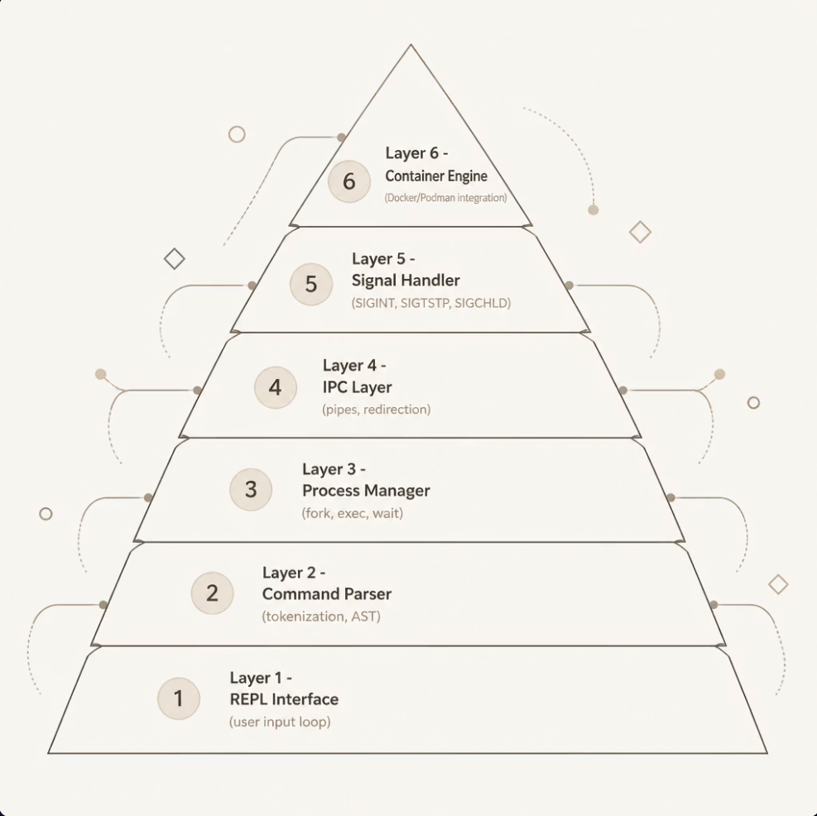
Architecture Overview
Layered Design
The shell is structured as a layered pipeline. User input flows from the REPL through parsing, process creation, and IPC — with signal handling and container operations integrated at the appropriate layers.
Clean separation of concerns between modules
Each layer communicates via well-defined interfaces
Container engine sits at the top as the highest-level abstraction

Slide 6







Project Modules
REPL Interface
Command Parser
Process Manager
Command input loop and built-in execution.
Tokenization and command interpretation.
fork(), exec(), wait() – foreground/background.
IPC & Redirection
Signal & Job Control
Container Ops
Pipes and input/output redirection.
SIGINT, SIGTSTP, SIGCHLD – full management.
Create, start, stop, remove, list, and monitor.
Concurrency & Monitoring
Threads for real-time CPU and memory resource monitoring.

Slide 7






Project Timeline
Weeks 3-4 Core Logic
Weeks 7-8 IPC & Testing
Weeks 11-12 Integration
Parser, AST, process creation.
Pipes, memory testing (Valgrind).
Job control, container ops & docs.
Weeks 1-2 REPL & Setup
Weeks 5-6 Environment
Weeks 9-10 Concurrency
Makefile, memory management.
PATH resolution, built-in commands.
I/O redirection, threads, monitoring.
A 12-week incremental build plan culminating in a fully integrated container-aware shell.

Slide 8






Expected Outcomes
Functional Shell
Unified Container CLI
A fully interactive Linux shell capable of executing arbitrary commands with comprehensive parsing and syntax support.
A single interface to seamlessly create, start, stop, list, and monitor containers – completely removing the need for separate tooling.
OS Concepts Demonstrated
Reliable & Tested
Working, native implementations of OS-level pipes, redirection, signaling, job control, threads, and memory management.
Rigorously validated software using GDB and Valgrind to ensure correctness, memory safety, and highly efficient resource usage.

